Slide 1
Linked List
A linked list is a linear collection of data elements (called nodes), where the linear order is given by means of pointers.
Each node is divided into 2 parts:
1st part contains the information of the element.
2nd part is called the link field or next pointer field which contains the address of the next node in the list.

Slide 2
Uses of Linked List
The list is not required to be contiguously present in the memory. The node can reside any where in the memory and linked together to make a list. This achieves optimized utilization of space.
list size is limited to the memory size and doesn't need to be declared in advance.
Empty node can not be present in the linked list.
We can store values of primitive types or objects in the singly linked list.

Slide 3
Why use linked list over array?
Array contains following limitations:
The size of array must be known in advance before using it in the program.
Increasing size of the array is a time taking process. It is almost impossible to expand the size of the array at run time.
All the elements in the array need to be contiguously stored in the memory. Inserting any element in the array needs shifting of all its predecessors.

Slide 4
useful
Linked list is the data structure which can overcome all the limitations of an array. Using linked list is useful because,
It allocates the memory dynamically. All the nodes of linked list are non-contiguously stored in the memory and linked together with the help of pointers.
Sizing is no longer a problem since we do not need to define its size at the time of declaration. List grows as per the program's demand and limited to the available memory space.

Slide 5
Advantages over arrays
1) Dynamic size 2) Ease of insertion/deletion

Slide 6
Drawbacks:
1) Random access is not allowed. We have to access elements sequentially starting from the first node. So we cannot do binary search with linked lists efficiently with its default implementation.
2) Extra memory space for a pointer is required with each element of the list.
3) Not cache friendly. Since array elements are contiguous locations, there is locality of reference which is not there in case of linked lists.

Slide 7
Basic operations
Insert: Add a new node in the first, last or interior of the list.
Delete: Delete a node from the first, last or interior of the list.
Search: Search a node containing particular value in the linked list.

Slide 8
A node can be added in three ways 1) At the front of the linked list 2) After a given node. 3) At the end of the linked list.

Slide 9
Insert First
To add a new node to the head of the linear linked list, we need to construct a new node that is pointed by pointer newitem.
Assume there is a global variable head which points to the first node in the list.
The new node points to the first node in the list. The head is then set to point to the new node.

Slide 10
Insert First
To add a new node to the head of the linear linked list, we need to construct a new node that is pointed by pointer newitem.
Assume there is a global variable head which points to the first node in the list.
The new node points to the first node in the list. The head is then set to point to the new node.

Slide 11
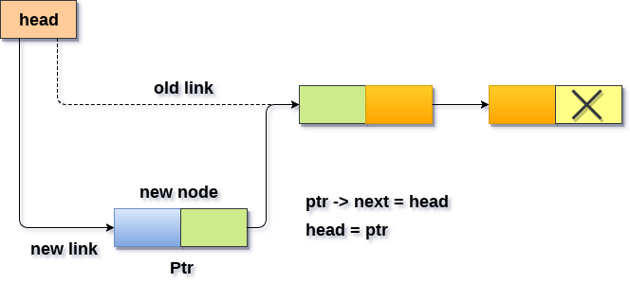
Step 1. Allocate the space for the new node and store data into the data part of the node.
Step2. Make the link part of the new node pointing to the existing first node of the list.
Sep3. At the last, we need to make the new node as the first node of the list.

Slide 12
Algorithm
Step 1: IF PTR = NULL
Write OVERFLOW Go to Step 7 [END OF IF]
Step 2: SET NEW_NODE = PTR
Step 3: SET PTR = PTR → NEXT
Step 4: SET NEW_NODE → DATA = VAL
Step 5: SET NEW_NODE → NEXT = HEAD
Step 6: SET HEAD = NEW_NODE
Step 7: EXIT

Slide 13
Algorithm
Step 1: IF PTR = NULL
Write OVERFLOW Go to Step 7 [END OF IF]
Step 2: SET NEW_NODE = PTR
Step 3: SET PTR = PTR → NEXT
Step 4: SET NEW_NODE → DATA = VAL
Step 5: SET NEW_NODE → NEXT = HEAD
Step 6: SET HEAD = NEW_NODE
Step 7: EXIT

Slide 14
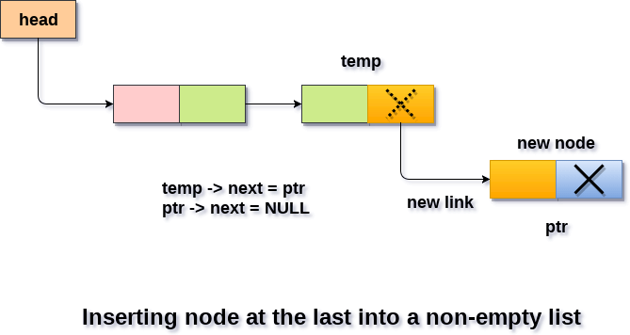
Insertion in singly linked list at the end

Slide 15
we need to declare a temporary pointer temp in order to traverse through the list. temp is made to point the first node of the list.
Then, traverse through the entire linked list using the statements:
At the end of the loop, the temp will be pointing to the last node of the list. Now, allocate the space for the new node, and assign the item to its data part. Since, the new node is going to be the last node of the list hence, the next part of this node needs to be pointing to the null. We need to make the next part of the temp node (which is currently the last node of the list) point to the new node (ptr) .

Slide 16
Algorithm
Step 1: IF PTR = NULL Write OVERFLOW Go to Step 1 [END OF IF]
Step 2: SET NEW_NODE = PTR
Step 3: SET PTR = PTR - > NEXT
Step 4: SET NEW_NODE - > DATA = VAL
Step 5: SET NEW_NODE - > NEXT = NULL
Step 6: SET PTR = HEAD
Step 7: Repeat Step 8 while PTR - > NEXT != NULL
Step 8: SET PTR = PTR - > NEXT [END OF LOOP]
Step 9: SET PTR - > NEXT = NEW_NODE
Step 10: EXIT

Slide 17
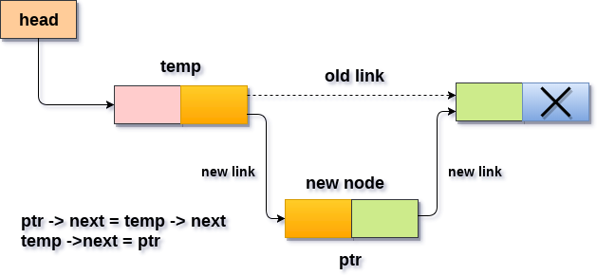
Insertion after specified Node

Slide 18
Insertion after specified Node
Allocate the space for the new node and add the item to the data part of it.
Now, we just need to make a few more link adjustments and our node at will be inserted at the specified position. Since, at the end of the loop, the loop pointer temp would be pointing to the node after which the new node will be inserted. Therefore, the next part of the new node ptr must contain the address of the next part of the temp (since, ptr will be in between temp and the next of the temp).
now, we just need to make the next part of the temp, point to the new node ptr. This will insert the new node ptr, at the specified position.

Slide 19
Algorithm
STEP 1: IF PTR = NULL
WRITE OVERFLOW GOTO STEP 12 END OF IF
STEP 2: SET NEW_NODE = PTR
STEP 3: NEW_NODE → DATA = VAL
STEP 4: SET TEMP = HEAD
STEP 5: SET I = 0
STEP 6: REPEAT STEP 5 AND 6 UNTIL I<loc< li=""></loc<>
STEP 7: TEMP = TEMP → NEXT
STEP 8: IF TEMP = NULL
WRITE "DESIRED NODE NOT PRESENT" GOTO STEP 12 END OF IF END OF LOOP
STEP 9: PTR → NEXT = TEMP → NEXT
STEP 10: TEMP → NEXT = PTR
STEP 11: SET PTR = NEW_NODE
STEP 12: EXIT

Slide 20
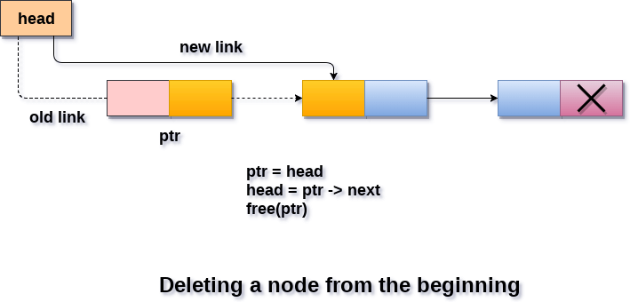
Deletion at beginning

Slide 21
Deleting a node from the beginning of the list is the simplest operation of all. It just need a few adjustments in the node pointers. Since the first node of the list is to be deleted, therefore, we just need to make the head, point to the next of the head.

Slide 22
Algorithm
Step 1: IF HEAD = NULL
Write UNDERFLOW Go to Step 5 [END OF IF]
Step 2: SET PTR = HEAD
Step 3: SET HEAD = HEAD -> NEXT
Step 4: FREE PTR
Step 5: EXIT

Slide 23
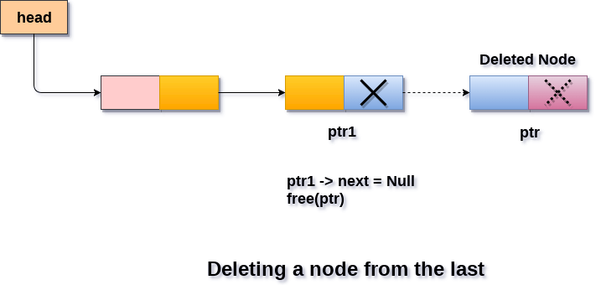
Deletion in singly linked list at the end

Slide 24
Algorithm
Step 1: IF HEAD = NULL
Write UNDERFLOW Go to Step 8 [END OF IF]
Step 2: SET PTR = HEAD
Step 3: Repeat Steps 4 and 5 while PTR -> NEXT!= NULL
Step 4: SET PREPTR = PTR
Step 5: SET PTR = PTR -> NEXT
[END OF LOOP]
Step 6: SET PREPTR -> NEXT = NULL
Step 7: FREE PTR
Step 8: EXIT

Slide 25
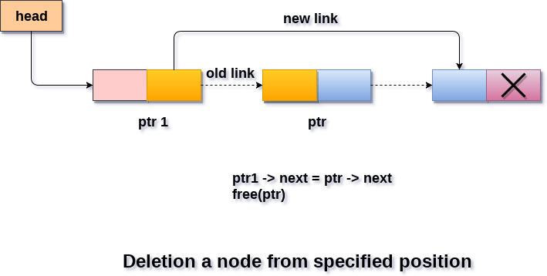
Deletion after the specified node :

Slide 26
Algorithm
STEP 1: IF HEAD = NULL
WRITE UNDERFLOW GOTO STEP 10 END OF IF
STEP 2: SET TEMP = HEAD
STEP 3: SET I = 0
STEP 4: REPEAT STEP 5 TO 8 UNTIL I<loc< li=""></loc<>
STEP 5: TEMP1 = TEMP
STEP 6: TEMP = TEMP → NEXT
STEP 7: IF TEMP = NULL
WRITE "DESIRED NODE NOT PRESENT" GOTO STEP 12 END OF IF
STEP 8: I = I+1
END OF LOOP
STEP 9: TEMP1 → NEXT = TEMP → NEXT
STEP 10: FREE TEMP
STEP 11: EXIT

Slide 27
Searching in singly linked list
Searching is performed in order to find the location of a particular element in the list. Searching any element in the list needs traversing through the list and make the comparison of every element of the list with the specified element. If the element is matched with any of the list element then the location of the element is returned from the function.

Slide 28
Algorithm
Step 1: SET PTR = HEAD
Step 2: Set I = 0
STEP 3: IF PTR = NULL
WRITE "EMPTY LIST" GOTO STEP 8 END OF IF
STEP 4: REPEAT STEP 5 TO 7 UNTIL PTR != NULL
STEP 5: if ptr → data = item
write i+1 End of IF
STEP 6: I = I + 1
STEP 7: PTR = PTR → NEXT
[END OF LOOP]
STEP 8: EXIT

Slide 29
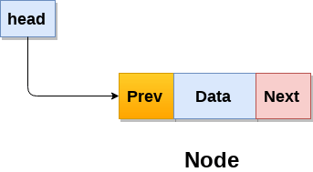
Doubly Linked List
Doubly linked list is a complex type of linked list in which a node contains a pointer to the previous as well as the next node in the sequence. Therefore, in a doubly linked list, a node consists of three parts: node data, pointer to the next node in sequence (next pointer) , pointer to the previous node (previous pointer). A sample node in a doubly linked list is shown in the figure.

Slide 31
Advantages over singly linked list 1) A DLL can be traversed in both forward and backward direction. 2) The delete operation in DLL is more efficient if pointer to the node to be deleted is given. 3) We can quickly insert a new node before a given node. In singly linked list, to delete a node, pointer to the previous node is needed. To get this previous node, sometimes the list is traversed. In DLL, we can get the previous node using previous pointer.

Slide 32
Disadvantages over singly linked list 1) Every node of DLL Require extra space for an previous pointer. It is possible to implement DLL with single pointer though (See this and this). 2) All operations require an extra pointer previous to be maintained. For example, in insertion, we need to modify previous pointers together with next pointers. For example in following functions for insertions at different positions, we need 1 or 2 extra steps to set previous pointer.

